Slide 1
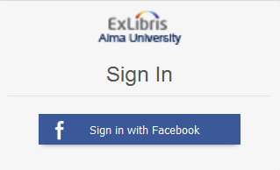

Alma Social Login
Yoel Kortick
Senior Librarian

Slide 2

Introduction
Technical Prerequisites
How it works - live demo
http://image.shutterstock.com/z/stock-photo-business-hand-writing-blank-agenda-list-130255148.jpg

Slide 3
Introduction
As of August 2016 it is possible to login to Alma using Facebook or Google.
This provides the Alma staff user with a safe, simple and convenient way of logging into Alma.
In the specific example here we will be setting up and using the social login for Facebook to login to Alma.

Slide 4
Introduction
Technical Prerequisites
How it works - live demo
http://image.shutterstock.com/z/stock-photo-business-hand-writing-blank-agenda-list-130255148.jpg

Slide 5
Technical Prerequisites – step 1
The first step is that the institution should have a dedicated Facebook account for the library.
This account will then (in the next step) be used to create an application to login to Alma.

Slide 6
Technical Prerequisites – step 2
The second step is for the institution to login to the developers site of Facebook at http://developers.facebook.com and create an application for allowing Social Login.
The process for doing this is described on the Ex Libris developer’s network at https://developers.exlibrisgroup.com/alma/integrations/user-management/authentication/social_login/oath_facebook
and
https://developers.exlibrisgroup.com/blog/Defining-Facebook-App-for-social-login-in-Alma

Slide 7
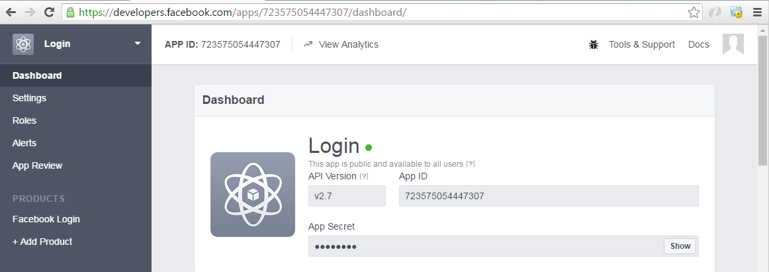
Technical Prerequisites – step 2
Here is the social login application we have created in the developers site of Facebook for the library. It is called “Login”
The App ID and App Secret will later be used in the Alma integration profile

Slide 8
Technical Prerequisites – step 3
The third step is for the institution to create an integration profile of type “Social Login” in Alma.
Use the App ID and App Secret from the Facebook App created on the Facebook developers site.
The process for creating this integration profile is described at
https://developers.exlibrisgroup.com/alma/integrations/user-management/authentication/social_login/oath_facebook
and
https://knowledge.exlibrisgroup.com/Alma/Product_Documentation/Alma_Online_Help_%28English%29/Integrations_with_External_Systems/050User_Management/Social_Login

Slide 9
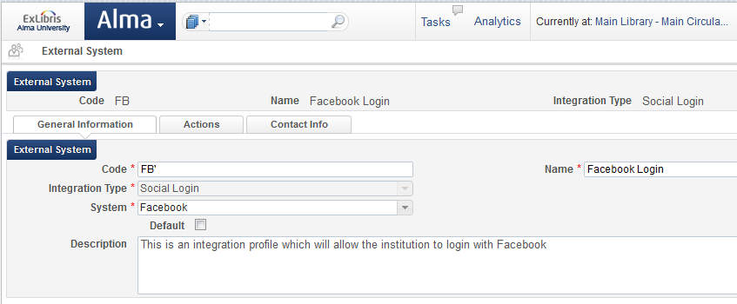
Technical Prerequisites – step 3
Here is the “General Information” tab of the integration profile we have created in Alma. It is called “Facebook Login”

Slide 10
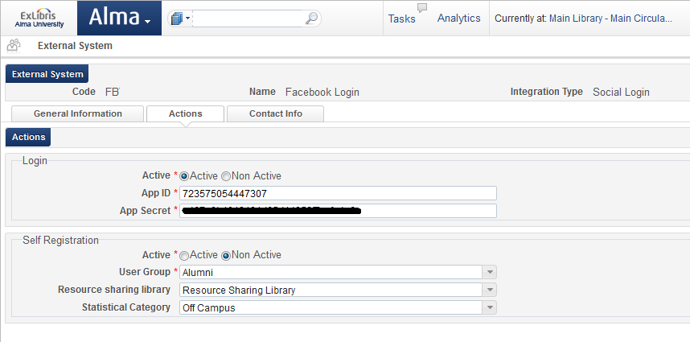
Technical Prerequisites – step 3
Here is the “Action” tab of the integration profile we have created for the library.
The App ID and App Secret (blocked out for security reasons) are from the Facebook Application

Slide 11
Introduction
Technical Prerequisites
How it works - live demo
http://image.shutterstock.com/z/stock-photo-business-hand-writing-blank-agenda-list-130255148.jpg

Slide 12
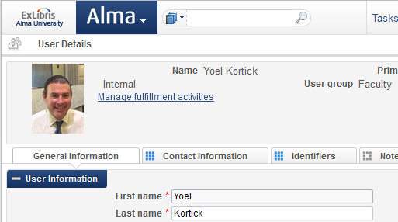
How it works - live demo
Staff user already exists in Alma

Slide 13
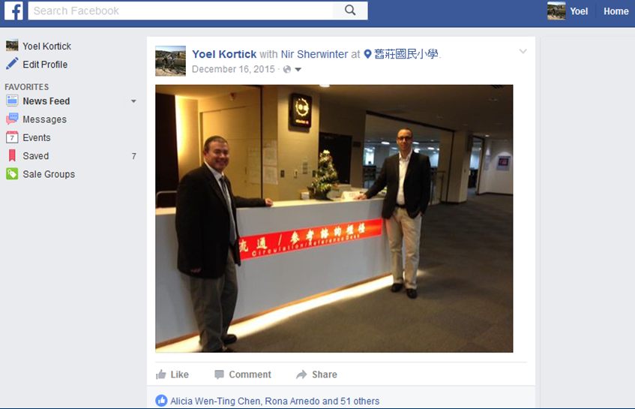
How it works - live demo
The same staff user has a Facebook account

Slide 14

How it works - live demo
The library sends the staff user a letter inviting him to use the Facebook social login to login to Alma.
This may be done either
  to a specific user from within the user record or
  to a set of users using the job “Update/Notify users”…
Here we send to a specific user from within the user record

Slide 15
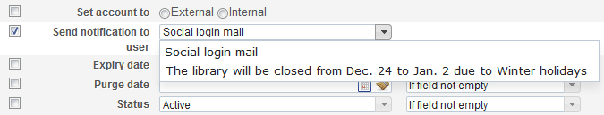
How it works - live demo
Here we sent the letter to a set of users via the job “Update/Notify Users”
Note: In both cases this will send the letter “Social Login Invite Letter” which, like all letters, may be customized by the institution.

Slide 16
How it works - live demo
The staff user gets an email

Slide 17
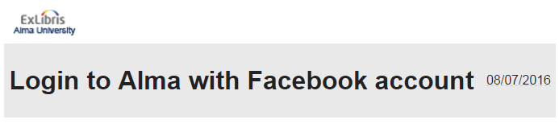
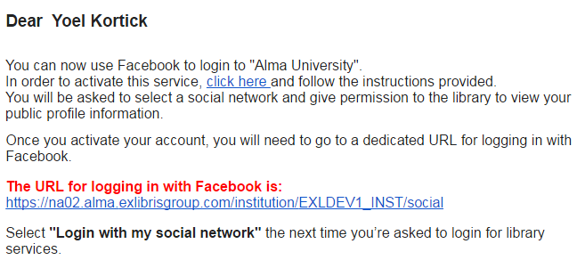
How it works - live demo
Here is the customized letter

Slide 18
How it works - live demo
The “click here” link in the letter will either
  Prompt the user to login to Facebook and then associate his Facebook account with his Alma staff user account
    This will occur if he is not already logged into Facebook in the same browser where the link opens
  Automatically associate his Facebook account with his Alma staff user account
    This will occur if he is already logged into Facebook in the same browser where the link opens (and the browser is using cookies)

Slide 19
How it works - live demo
After the staff user account is associated with the Facebook account the URL for logging into Facebook is always the same “regular” URL for the Alma institution plus a suffix of “/social”
Thus if the URL of the institution is
https://ap01.alma.exlibrisgroup.com/institution/613NE_TECH_INST
Then the login for using Facebook as the social login will be
https://ap01.alma.exlibrisgroup.com/institution/613NE_TECH_INST/social

Slide 20
How it works - live demo
Now the user clicks the link and it will open in a browser where he is already logged into Facebook
User receives email and clicks here

Slide 21
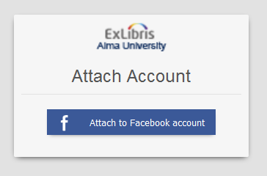
How it works - live demo
The user now receives in his browser a link to attach his Alma user account to his Facebook account

Slide 22
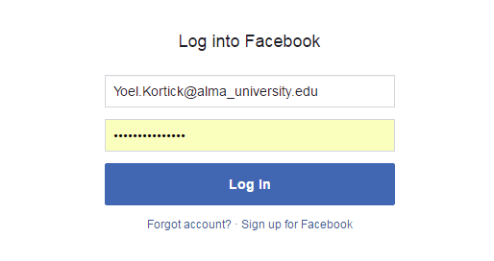
How it works - live demo
The user then logs into Facebook (if he is not already logged in)

Slide 23
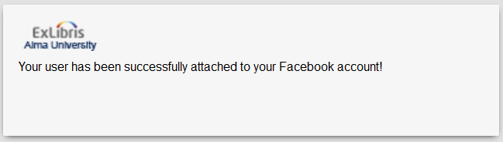
How it works - live demo
The user then receives confirmation

Slide 24
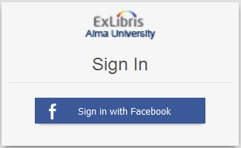
How it works - live demo
Now the user can login to the URL with “/social” at the end and sign in with Facebook, for example
https://ap01.alma.exlibrisgroup.com/institution/613NE_TECH_INST/social

Slide 25

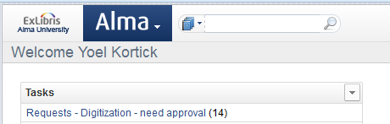
How it works - live demo
The URL will redirect and the user is logged in to Alma

Slide 26
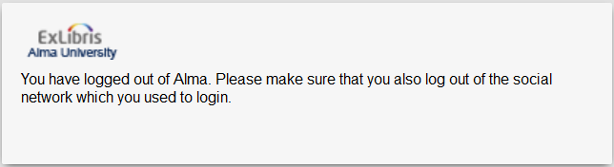
How it works - live demo
Upon logging out of Alma the user will get the following message

Slide 27
Thank You
Yoel Kortick
Senior Librarian

